Slide 1
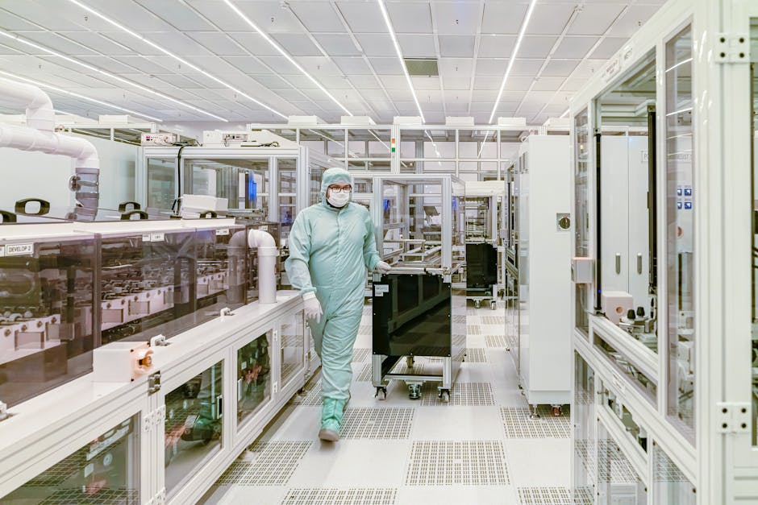
Project QuantumForge
KELP LOGO
Defense & Space Electronics | Investment Teaser
BUSINESS PROFILE
• Tier-1 Strategic Partner to ISRO, DRDO, and Global Defense Primes (Thales, Rafael).
• 3 State-of-the-art Manufacturing Units (AS9100D Certified) in Bangalore & Hyderabad.
• Diversified Revenue Mix: 45% Exports (USA/EU) | 55% Domestic Strategic Projects.
KEY OFFERINGS
Missile Control Electronics
Satellite Payloads (Space-Grade)
Radar & EW Systems
Aero-Structure Assemblies
Strictly Private & Confidential – Prepared by Kelp M&A Team

Slide 2
Financial Performance
KELP LOGO
Operational Scale | Investment Teaser
REVENUE CAGR
18.5%
EBITDA MARGIN
22.0%
Strictly Private & Confidential – Prepared by Kelp M&A Team

Slide 3
Investment Highlights
KELP LOGO
Why Invest? | Investment Teaser
High Entry Barriers: Critical supplier for National Space Missions (e.g., Chandrayaan-3).
China+1 Beneficiary: Preferred manufacturing partner for Western Defense majors.
Margin Expansion: Shift from 'Build-to-Print' to high-margin 'Design-to-Spec' contracts.
Strictly Private & Confidential – Prepared by Kelp M&A Team

